Slide 1
Biweekly Update
February 6, 2023
The Little Engineers that Could: Blake, Sam, Melanie, and Amy

Slide 2
Progress
01
02
03
Modeling and Simulation
EX2 Breakdown
Writing

Slide 3
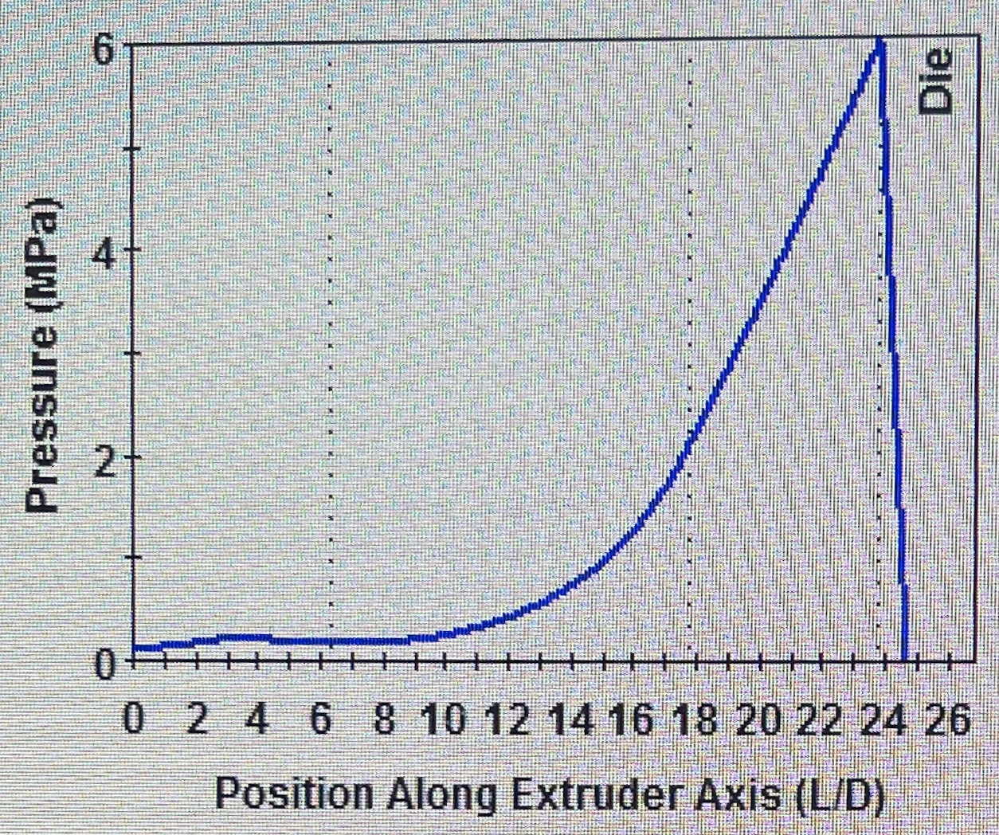
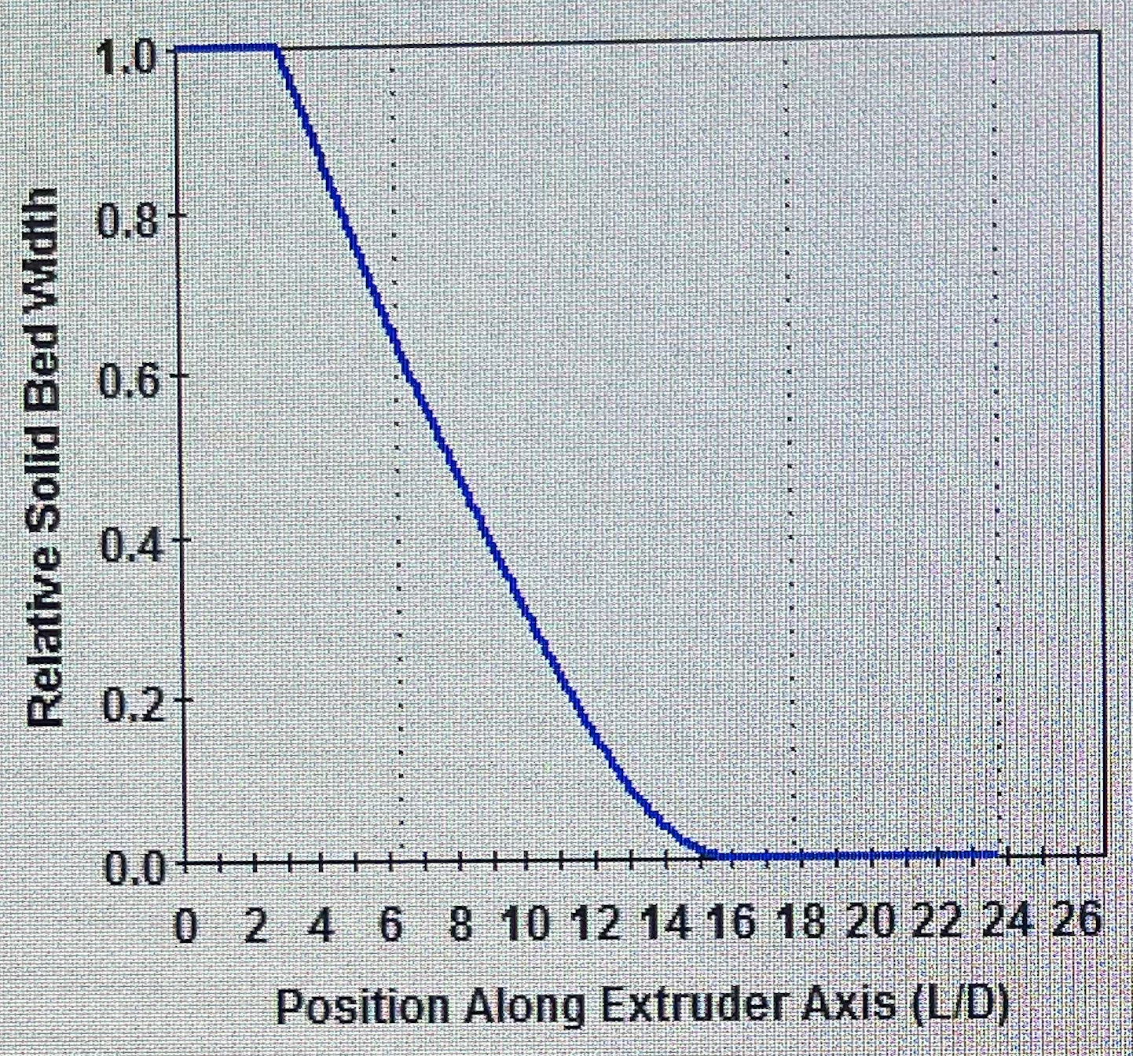
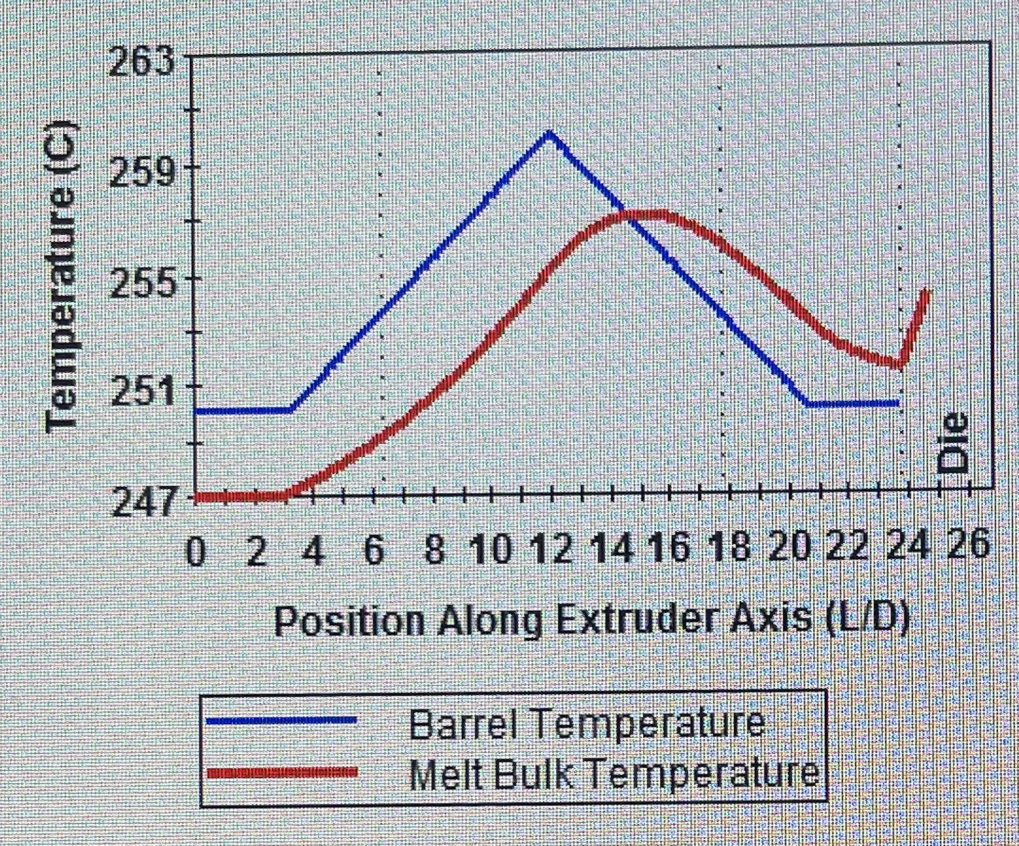
Modeling and Simulation

Slide 4
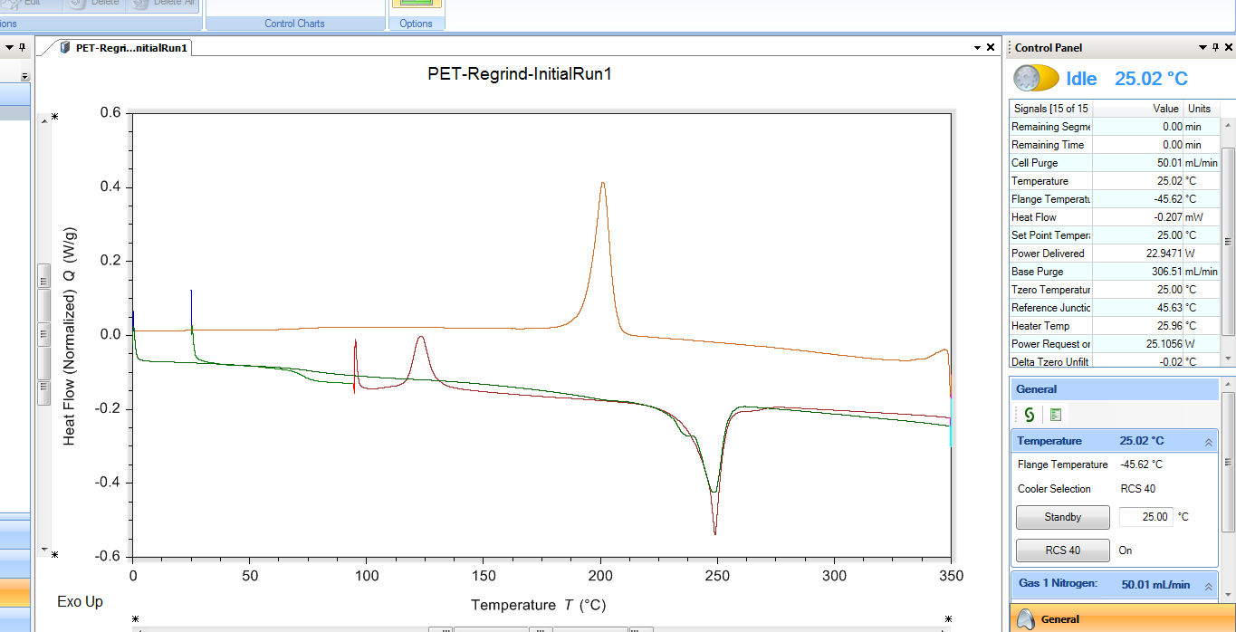
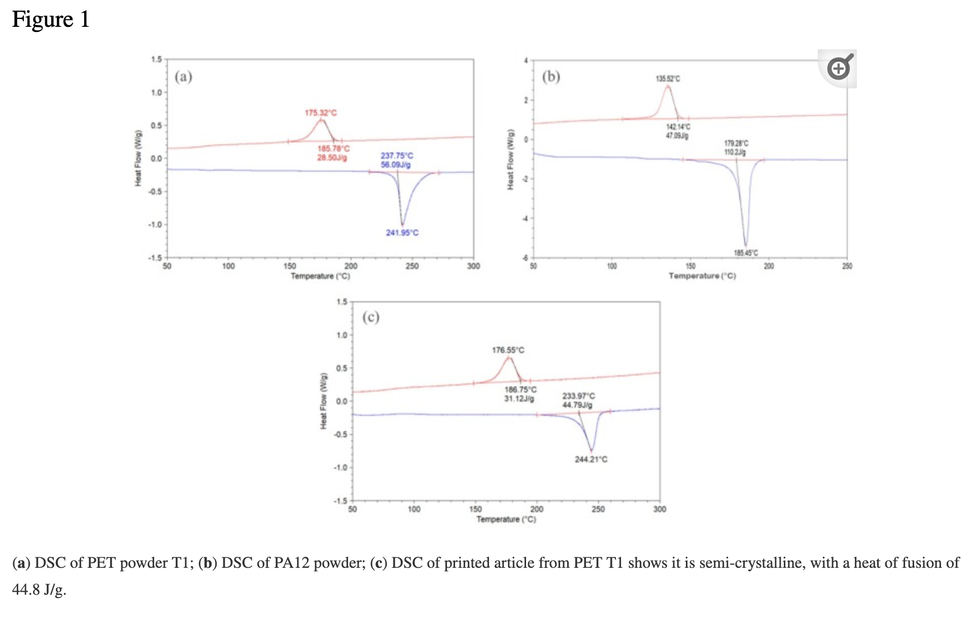
DSC Curves
H. Gu, F. AlFayez, T. Ahmed, and Z. Bashir, “Poly(ethylene terephthalate) powder—a versatile material for additive manufacturing,” Polymers, vol. 11, no. 12, p. 2041, 2019.

Slide 5
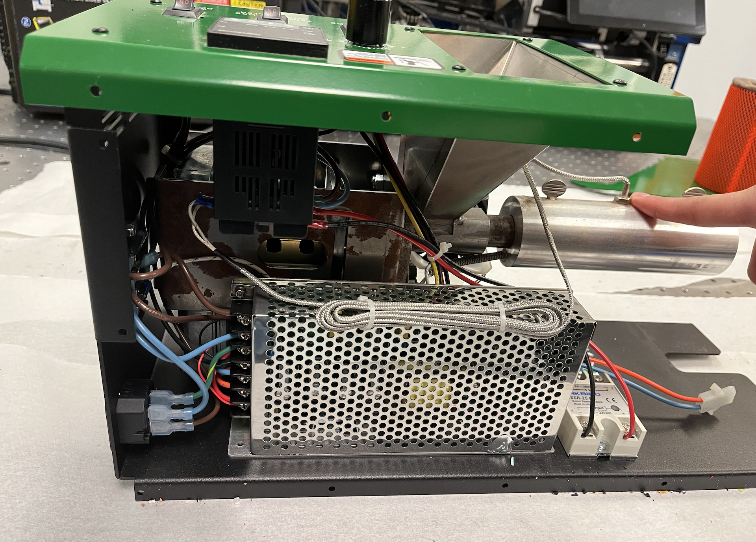
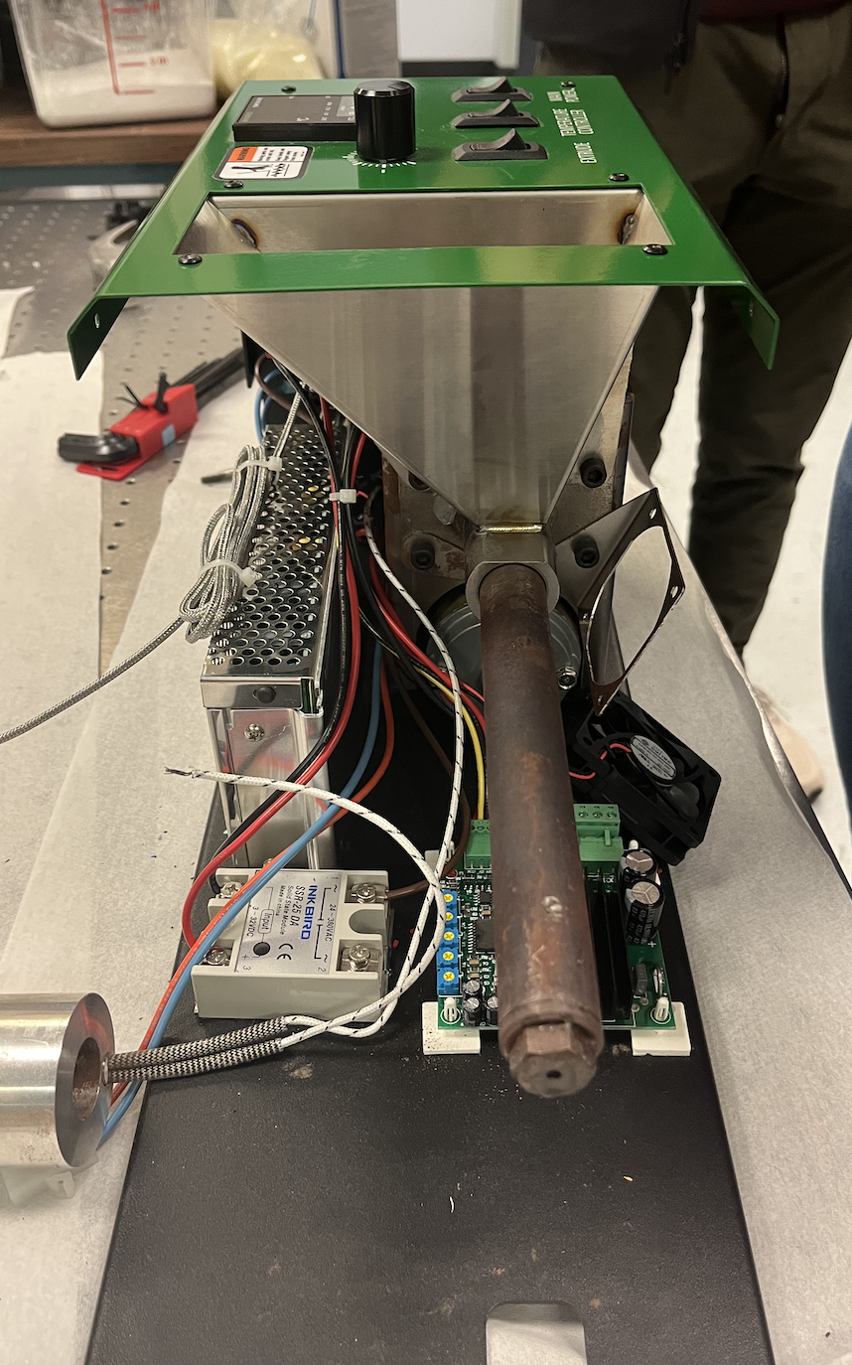
EX2 Breakdown

Slide 6
Necessary Parts List
Part | Source
Die | Manufacturer
Barrel | Machined
Screw | Manufacturer
Hopper | Manufacturer
Barrel Mount | David

Slide 7
Necessary Parts List Cont’d
Part | Source
Cooling Fan & Mount | Manufacturer
Heating Jacket | Manufacturer
Insulating Jacket | Manufacturer
Power Supply | Manufacturer
Temperature Controller (PID) | Inkbird ITC-100 (Inkbird or Amazon)
Electrical Panel | Manufacturer

Slide 8
Writing
Draft of introduction
Updated SOW

Slide 9
Action Items (2 weeks)
Design parts that need to be machined by David (SL)
Hopper/screw attachment
Motor/screw coupler
Flanged piece for coupler
Look into/begin Vanderbilt Green Fund Proposal application
Writing
Gantt Chart
Process Economics
Process Diagrams
FMEA & other safety/hazard analyses
Make necessary purchases

Slide 10
Purchases
Item Name | ID | Unit Cost | Quantity | Total Cost | Source
Poly(ethylene terephthalate) | 429252-250G | $106.00 | 1 | $106.00 | Sigma Aldrich
PET Bottle Recycler | Link | $286.00 | 1 | $286.00 | ebay
EX6 and MDPE10 extruder screws | EX6-120-C3 | $869.00 | 1 | $869.00 | FilaBot
Notes:
-quote from CT Polymers & Wood Mckenzie for recycled PET pellets

Slide 11
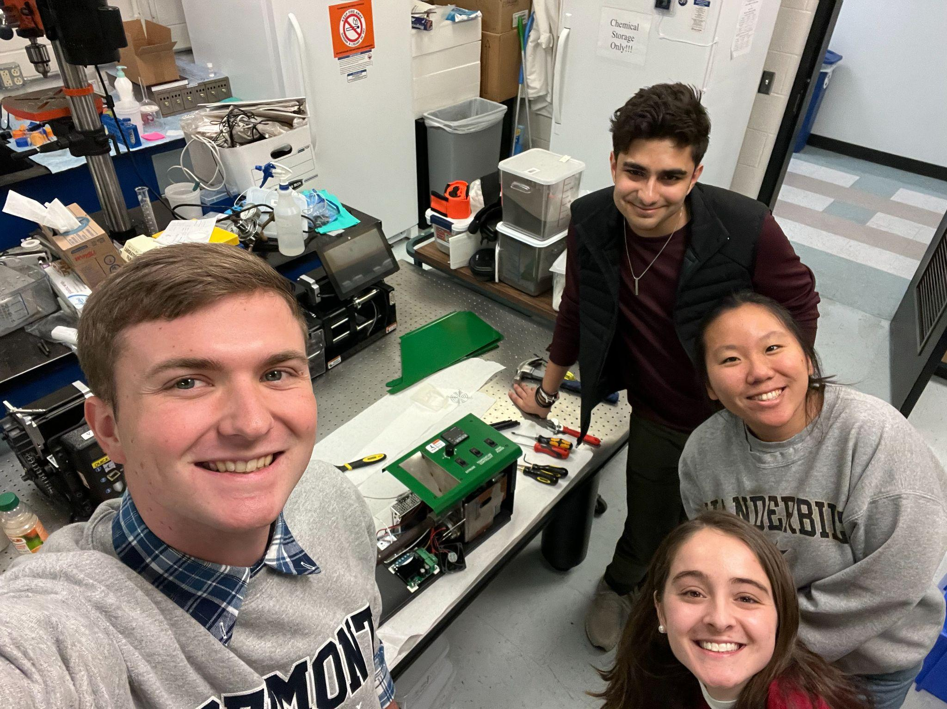
“You miss 100% of the shots you don’t take”
George Washington

